Slide 1
Epigenomic Profiling of oncogenic TBX2 in Mouse Mammary Epithelial Cells(mMEC) as a model for Breast Cancer
by : Martin Winn

Slide 2
Cancer
UCSC Tracks
Outline
Epigenomics
DiffBind
T-box genes
RemapEnrich

Slide 3
Combination Matrix Analysis
Outline
Conclusion
Acknowledgements

Slide 4
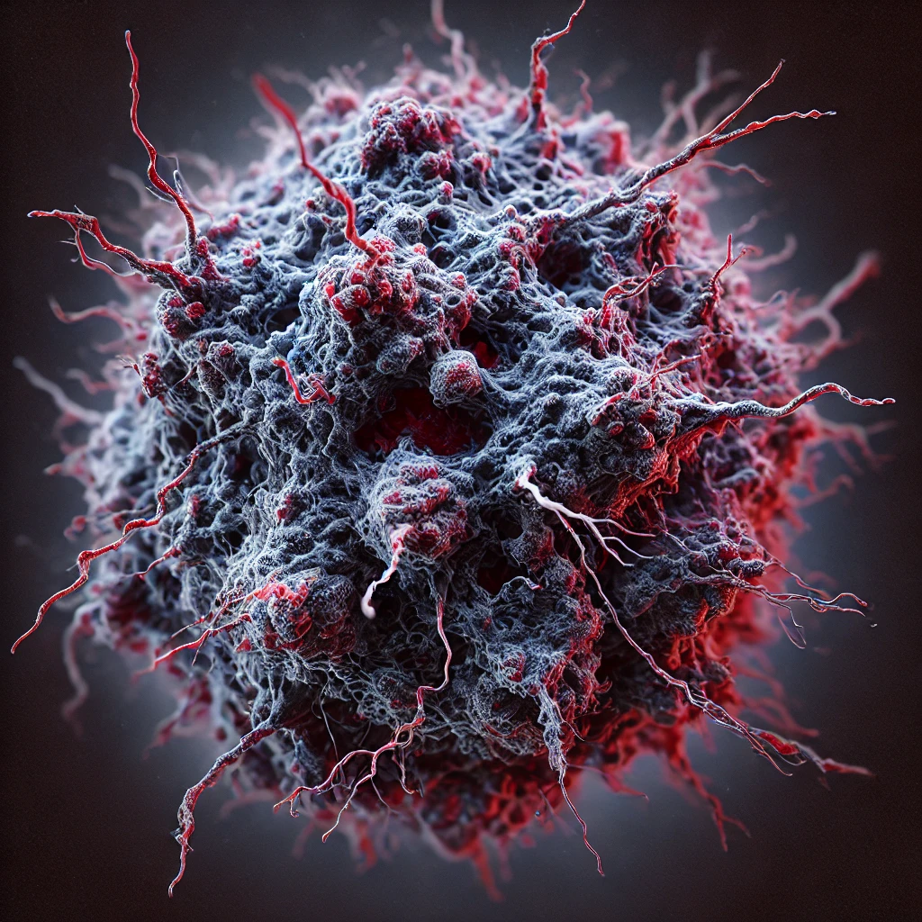
Cancer

Slide 5
Breast Cancer
Most common cancer in women
Subtypes: Basal, Luminal A, Luminal B, HER+, TNBC |
Luminal A :ER/PR positive, HER2 negative, low proliferation.
Luminal B: ER/PR positive, higher proliferation, can be HER2 positive or negative.
Basal: Often TNBC (no ER/PR/HER2) but variant proteins
Risk factors: Genetics BRCA1/2 gene mutations,reproductive health women who have never given birth (nulliparity) or early menarche increased risk, late menopause
Notes:
Breastfeeding has a protective effect
⅕ breast cancers are her2+(protein that promotes growth) HER2 inhibitors target the receptor

Slide 6
Ovarian Cancer
5th most common cause of cancer-related death in women
Subtypes: Epithelial, Germ, Stromal
Risk factors: Genetics BRCA1/2 gene mutations, Reproductive History women that have never given birth are at a higher risk, HRT estrogen replacement therapy without administration of progesterone can increase risk
Notes:
PARP inhibitors also used in breast cancer BRCA1/2

Slide 7
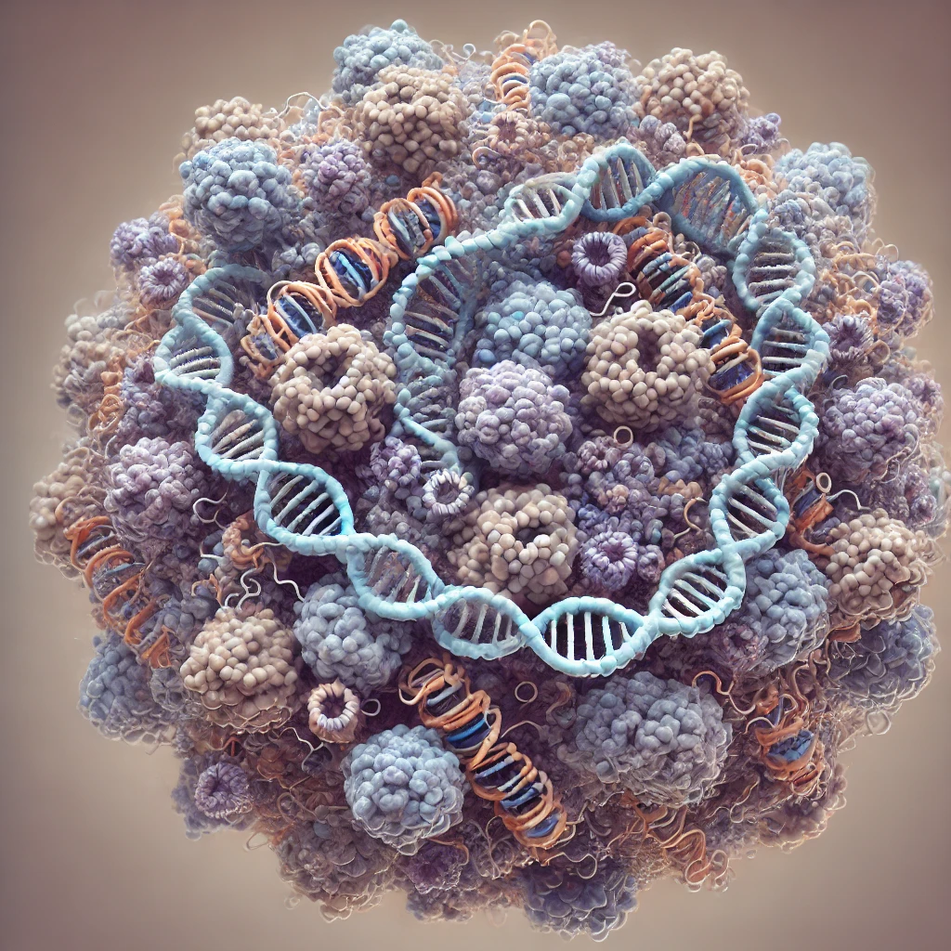
Epigenomics

Slide 8
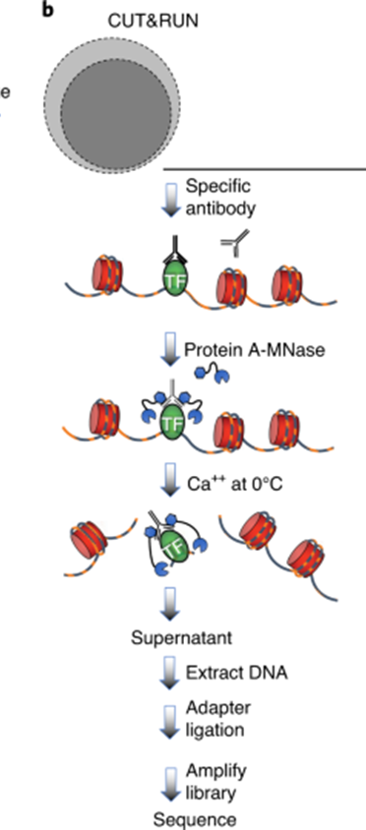
CUT&RUN
Function
Benefits
Applications
This assay is used to study the protein-DNA binding between transcription factors, and chromatin modifications by utilizing a specific antibody to bind to the protein and modification of interest and then using A-MNase binds to the Antibody and cleaves the DNA at that region allows the target to precipitate out of the cell.
The specificity of the A-MNase results in a lower signal to noise ratio in the background and fewer cells necessary for sequencing.
Primarily used to map binding site interactions to understand gene regulation through transcription factors or chromatin markers.
Kaya-Okur et al. Nature Protocols. 2014

Slide 9
Function
Function
Histone Modifications
Enzyme
Enzyme
H3K4me3
H3K27ac
Associated with the TSS regions of genes in active gene transcription.
Associated with enhancers and promoters in active gene transcriptional regions
The lysine residue at position 4 (K4) is methylated by methyltransferases (HMT)and demethylated by demethylases(HDT) such as KDM5, which induces gene repression.
The lysine residue at position 27 (K27) is acetylated by histone acetyltransferases(HATS) such as CBP and deacetylated by histone deacetylases(HDACs)

Slide 10
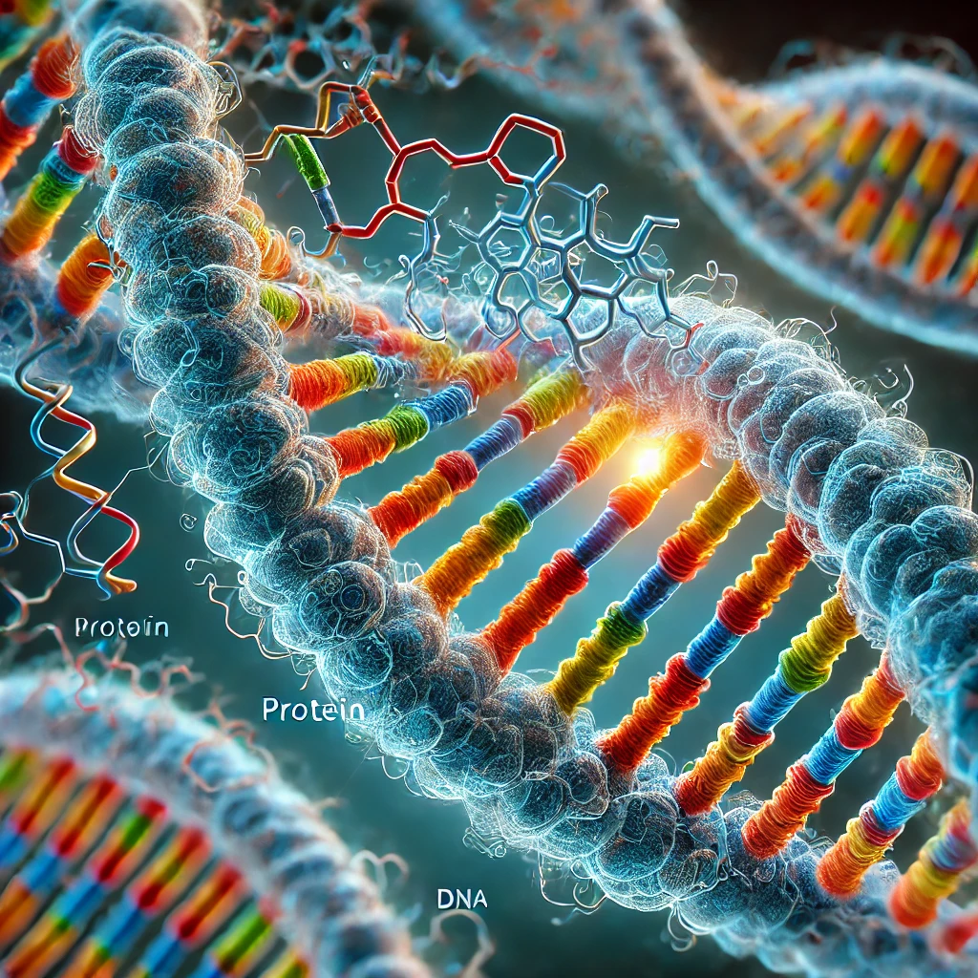
T-Box Genes

Slide 11
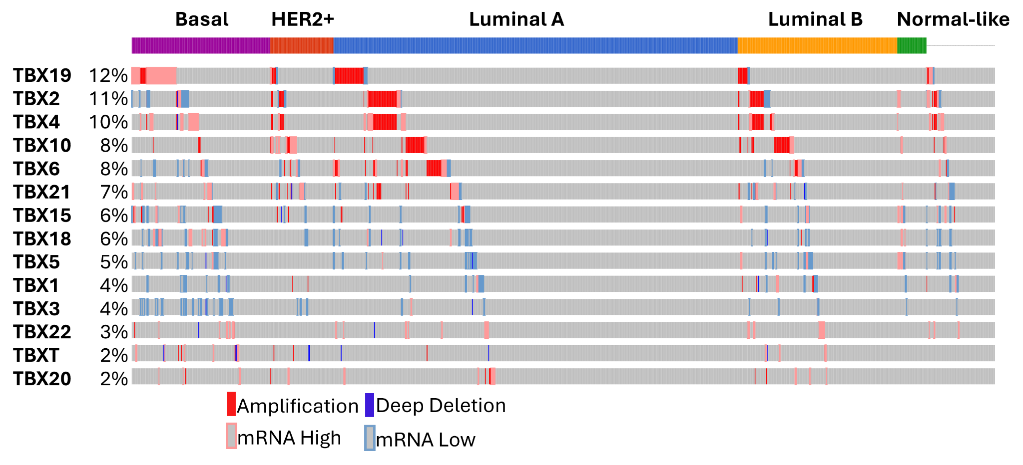
Definition
TBX2
Function
Cancer
T-box genes are a family of genes that code for transcription factors that contain a TATA box in the binding sites conserved across other family transcription factors.
Amik Munankarmy, M.B.B.S., M.D.
They are involved in cell differentiation, and patterning during embryonic development. Functions as repressor by binding to DNA
TBX2 overexpression is linked to poor prognosis and increasing epithelial to mesenchymal transition in breast cancer, where it acts as an oncogene potentially by repressing tumor suppressors.

Slide 12

Differential Binding

Slide 13
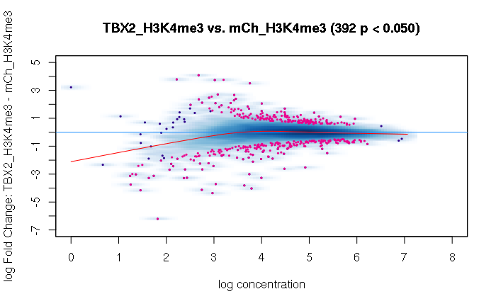
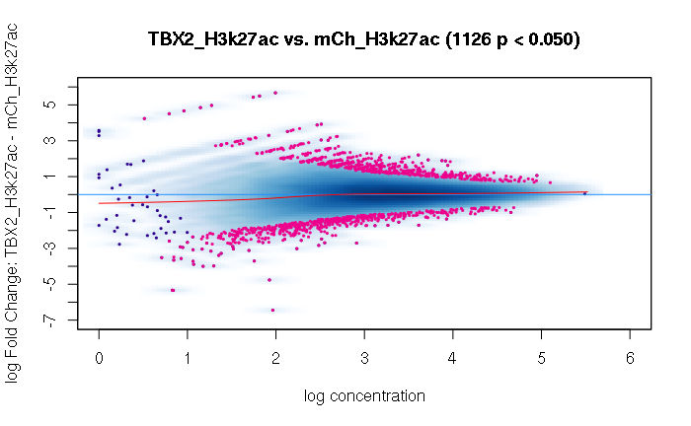
H3K4me3
H3K27ac
Notes:
Add number of points for enrichment and depletion for both H3K4me3 and H3k27ac

Slide 14

Remap Enrichment

Slide 15
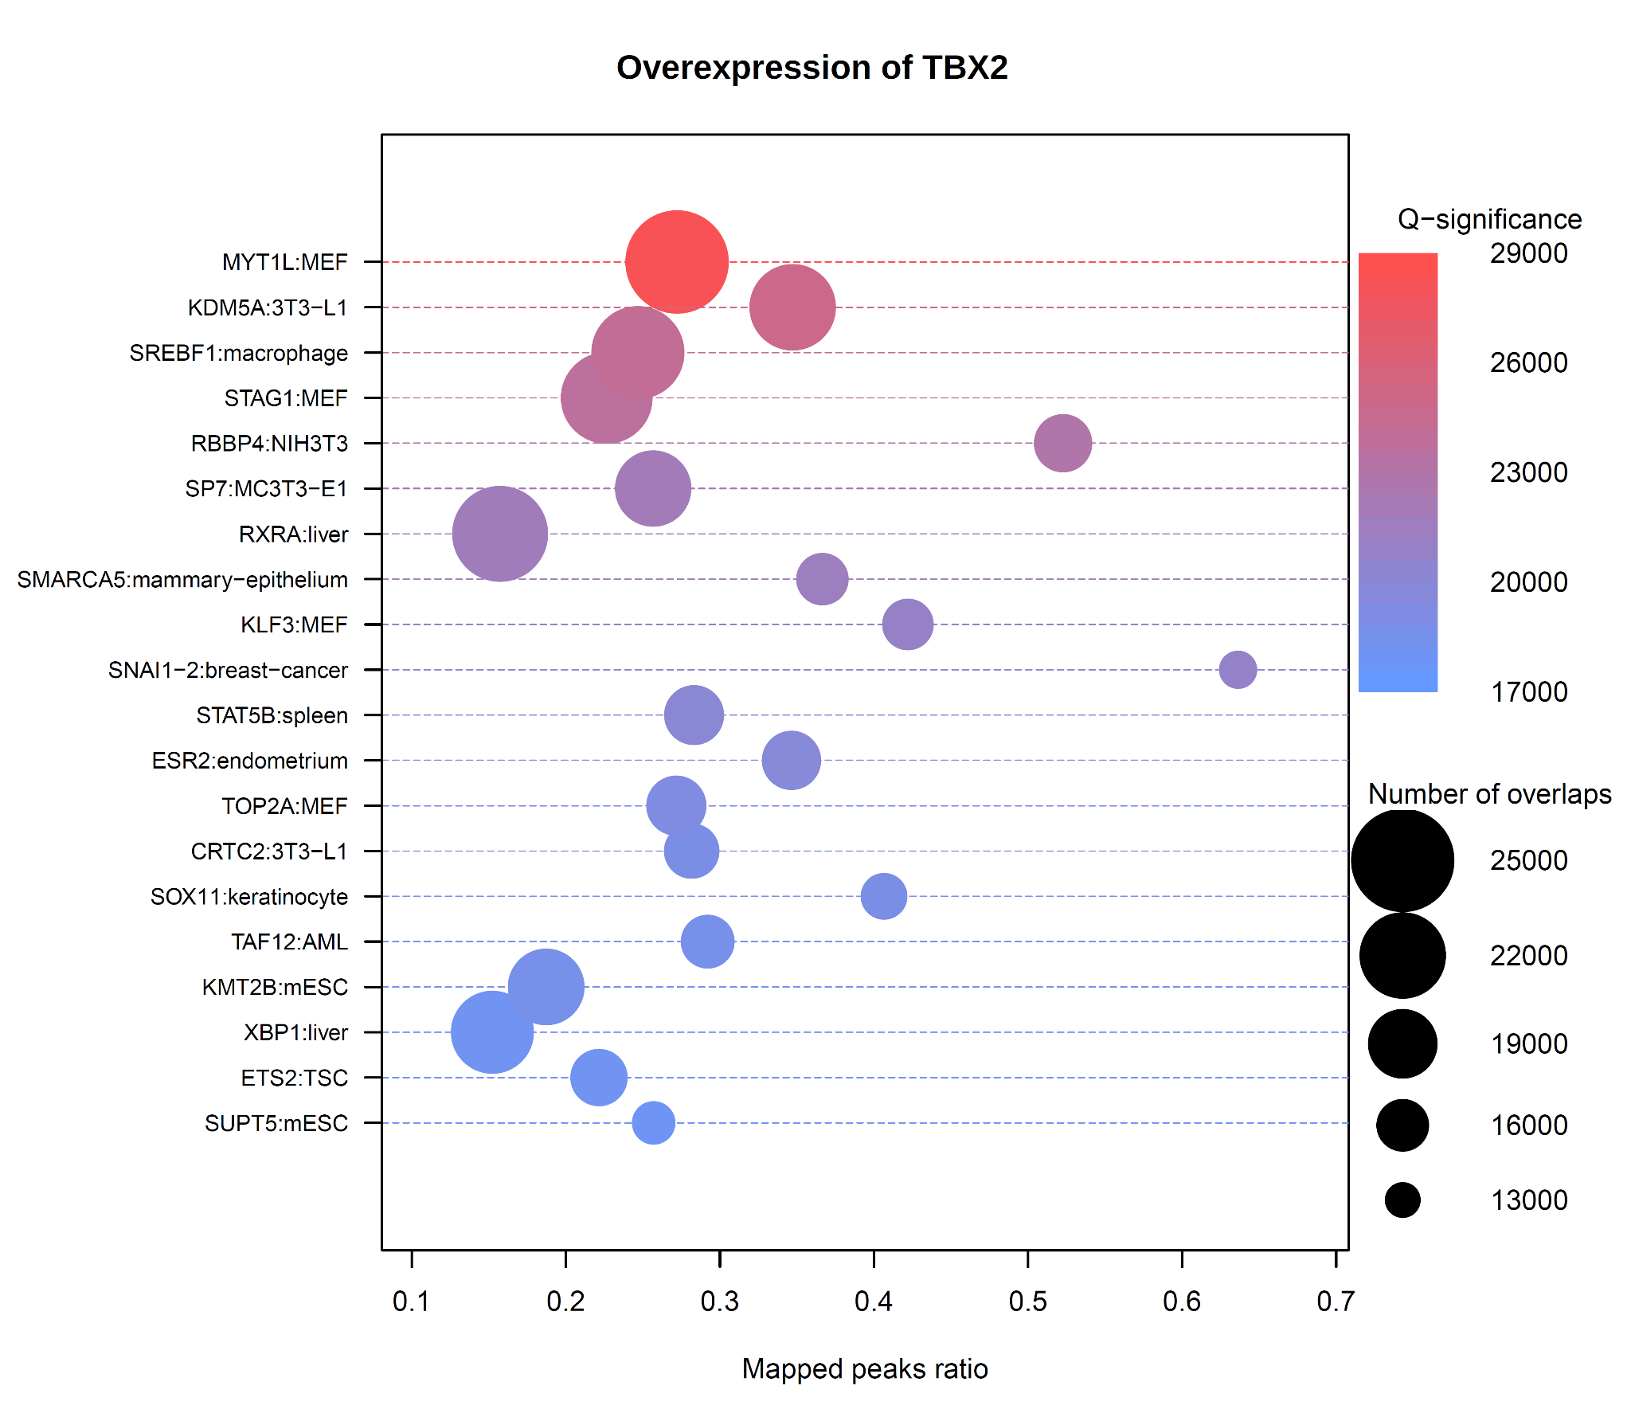
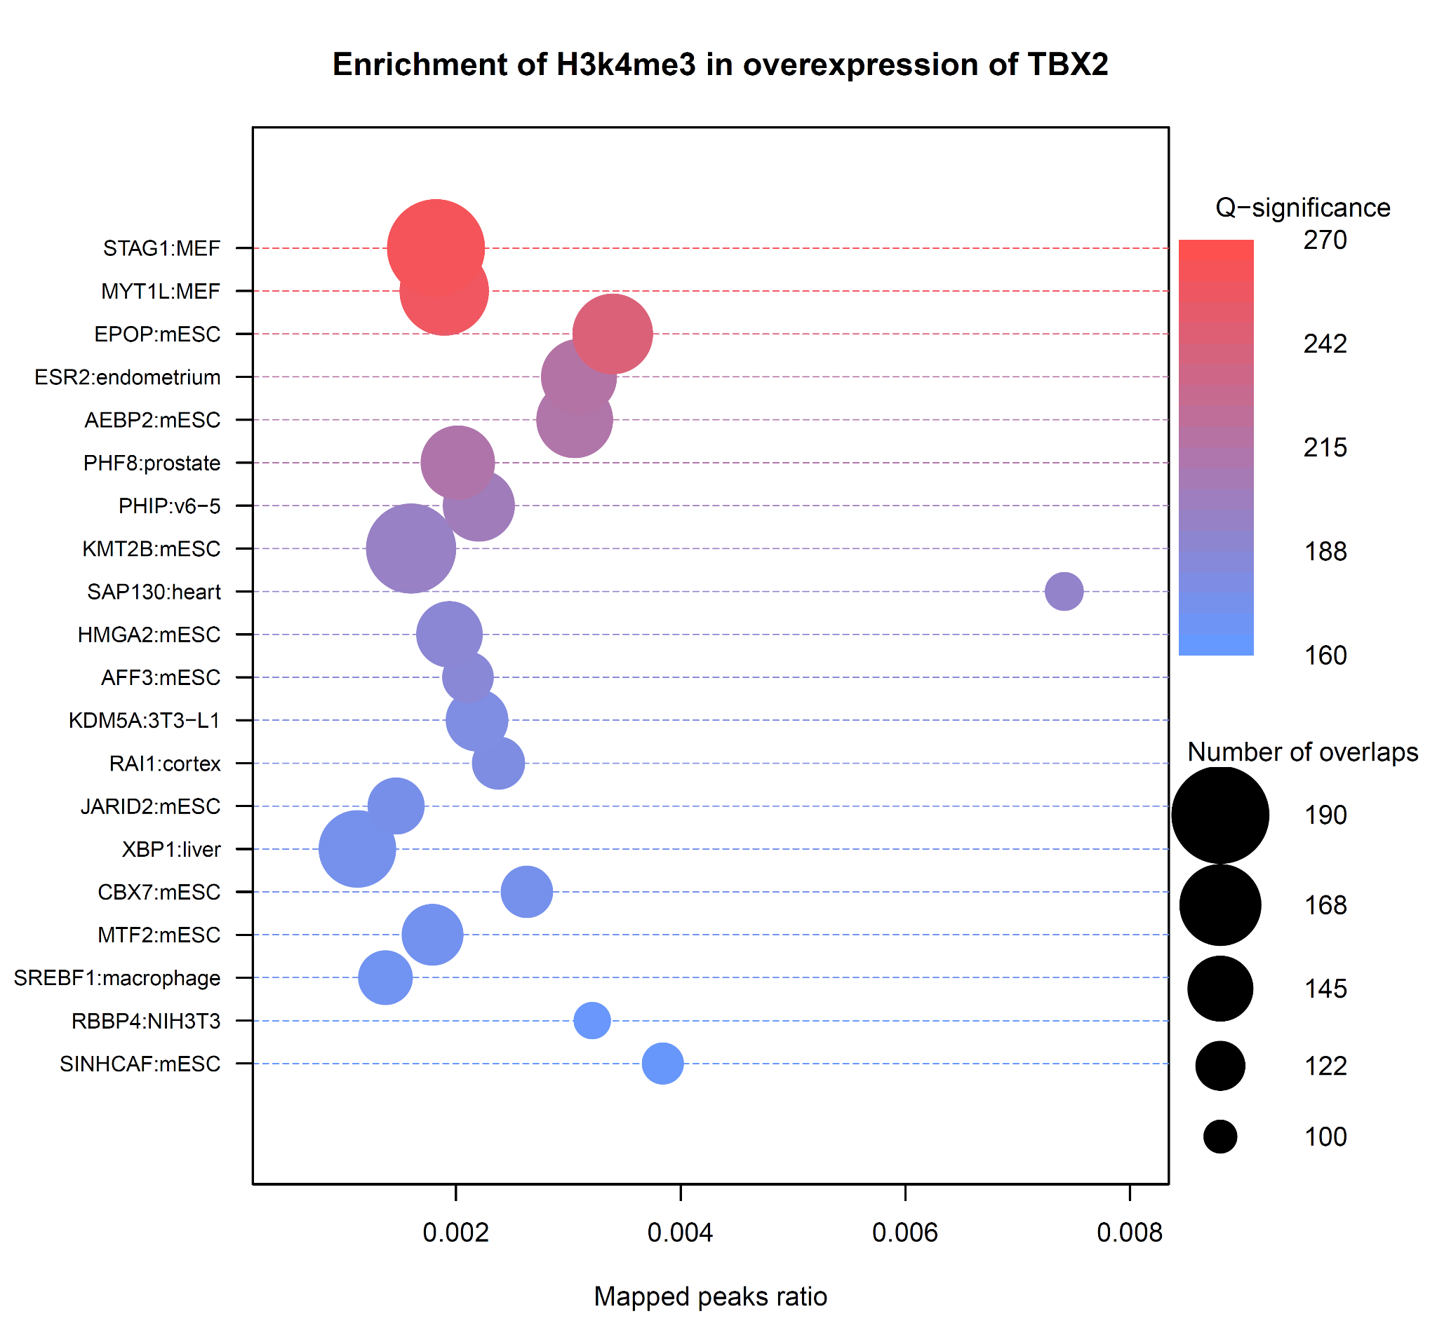
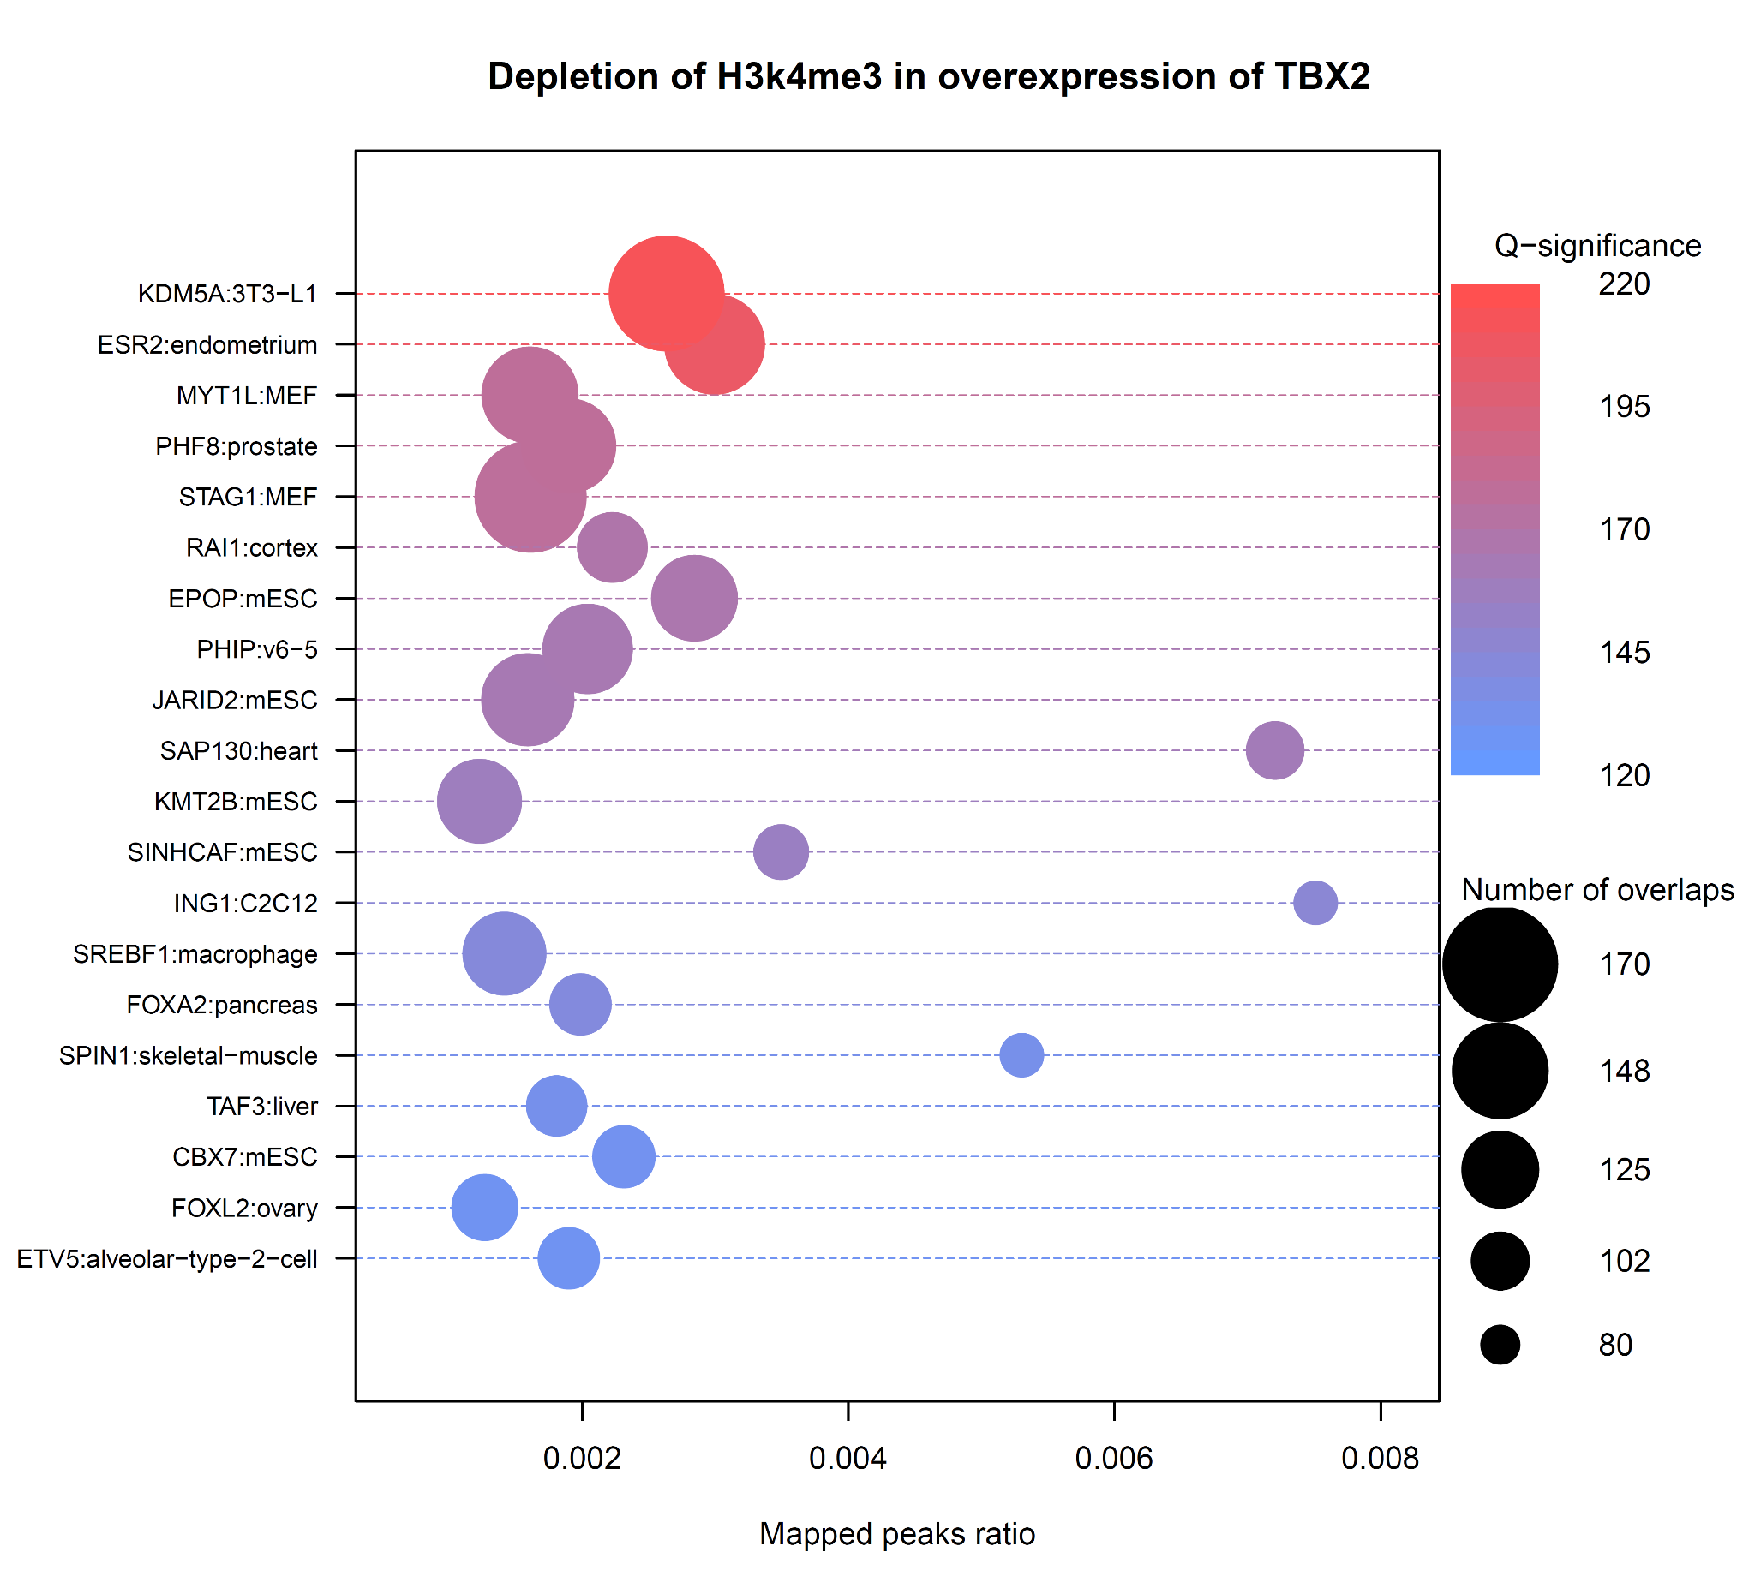
H3k4me3

Slide 16
Unique in Enrichment
Unique in Depletion
H3K4me3
AEBP2
HMGA2
AFF3
XBP1<-
MTF2
RBBP4 <-
ING1
FOXA2
SPIN1
TAF3
FOXL2
ETV5
H3K4me3 Function

Slide 17
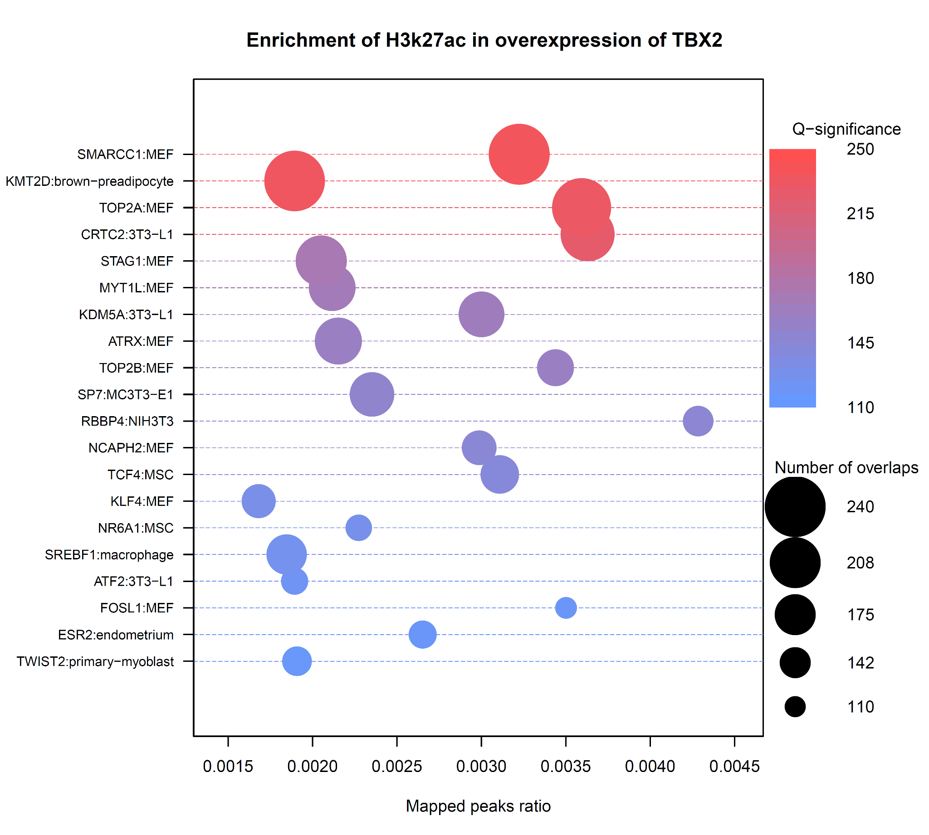
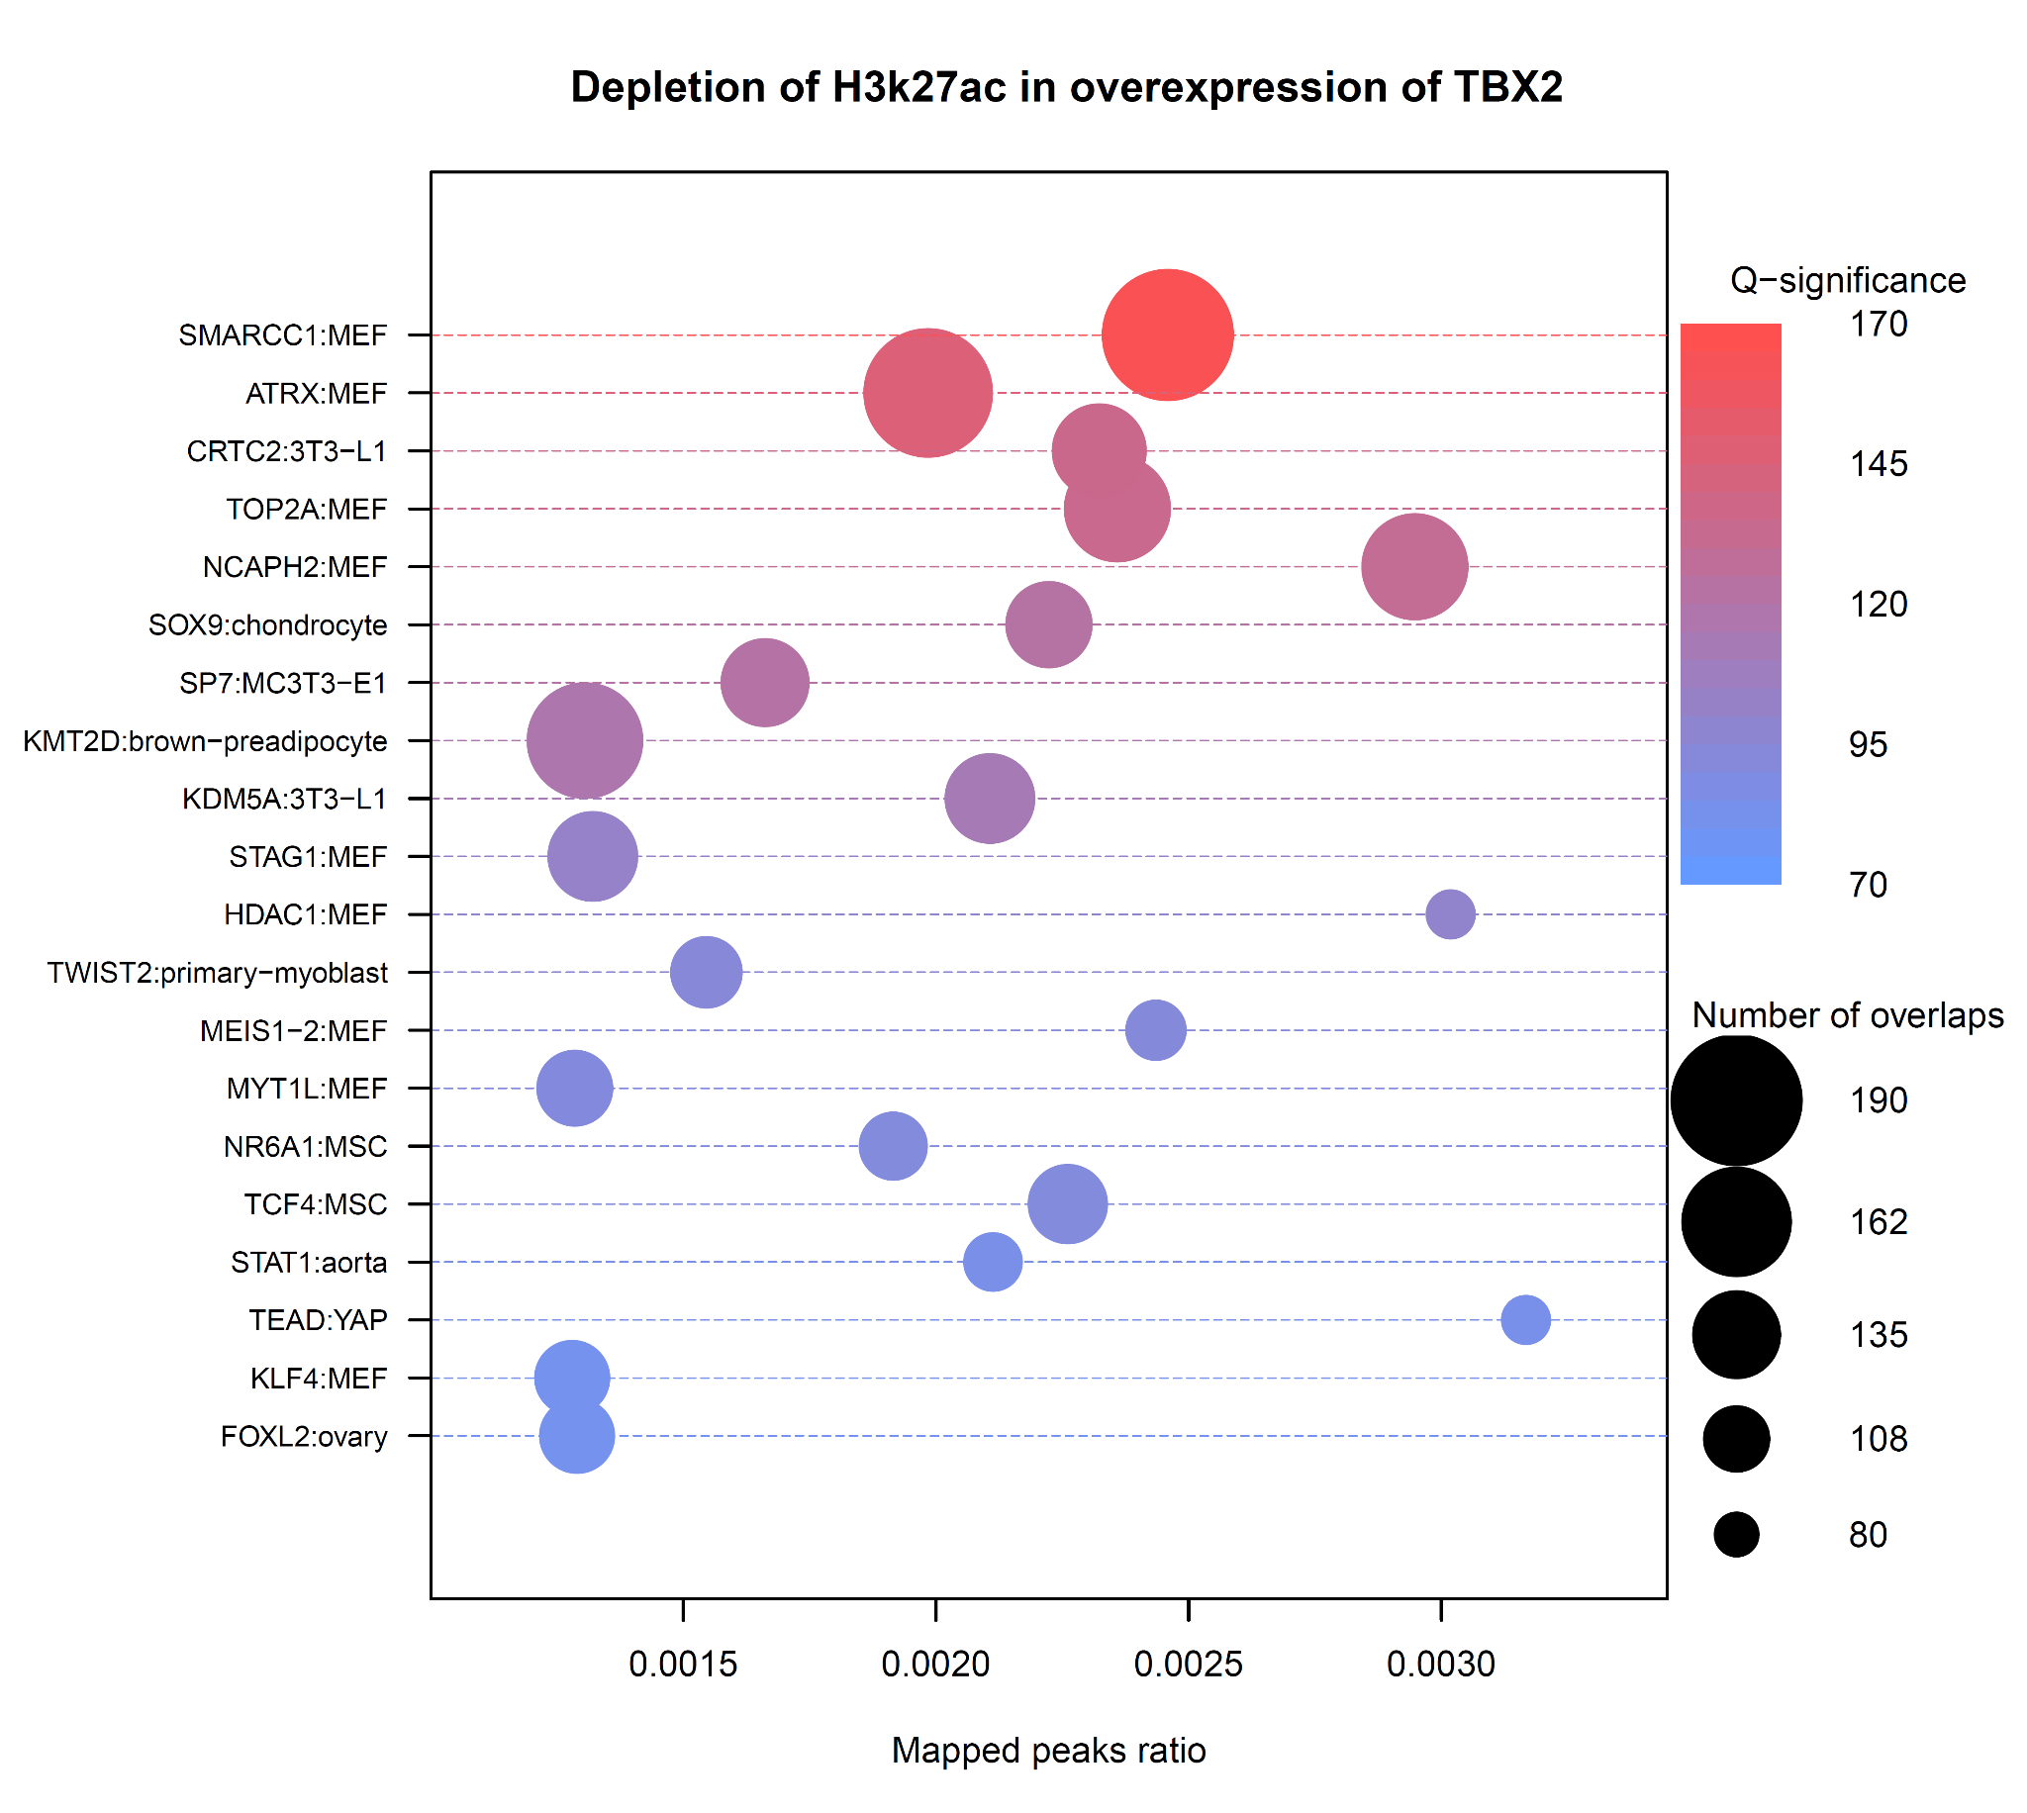
H3k27ac

Slide 18
Unique in Enrichment
Unique in Depletion
H3K27ac
TOP2B<-
RBBP4<-
ESR2
ATF2:3T3-L1
FOSL1
SOX9
HDAC1
STAT1
TEAD
FOXL2
H3K27ac Function

Slide 19
Unique in Enrichment
Interest
KDM5a
CD24a
Tiam1
H3K27ac Function

Slide 20
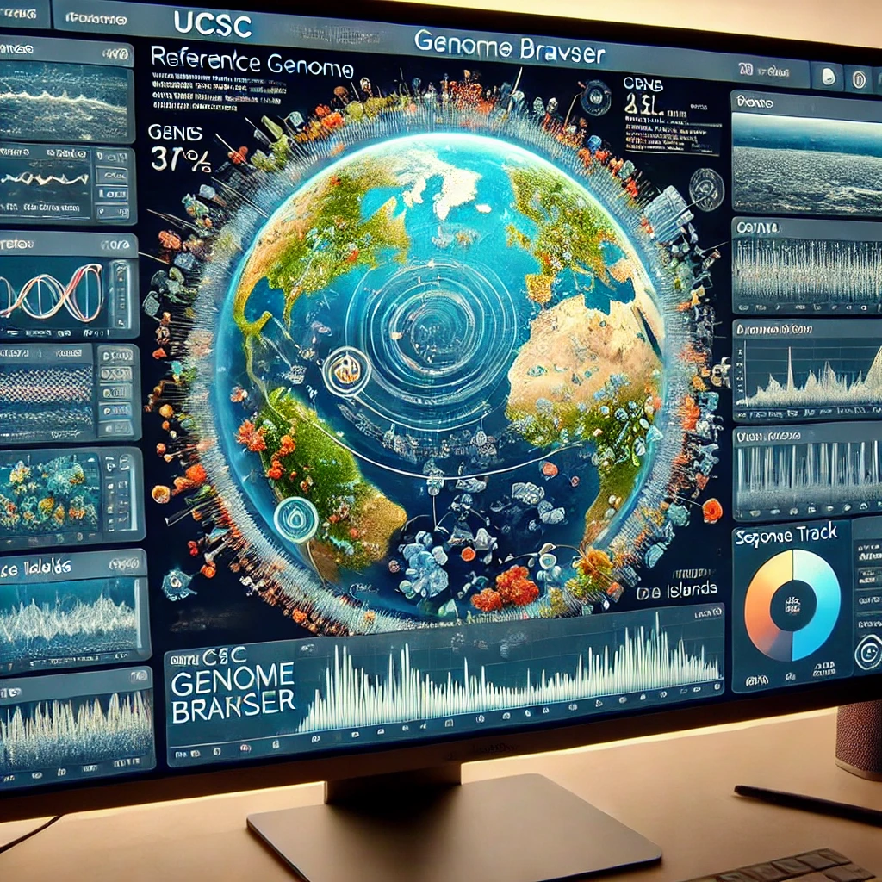
UCSC Tracks

Slide 21
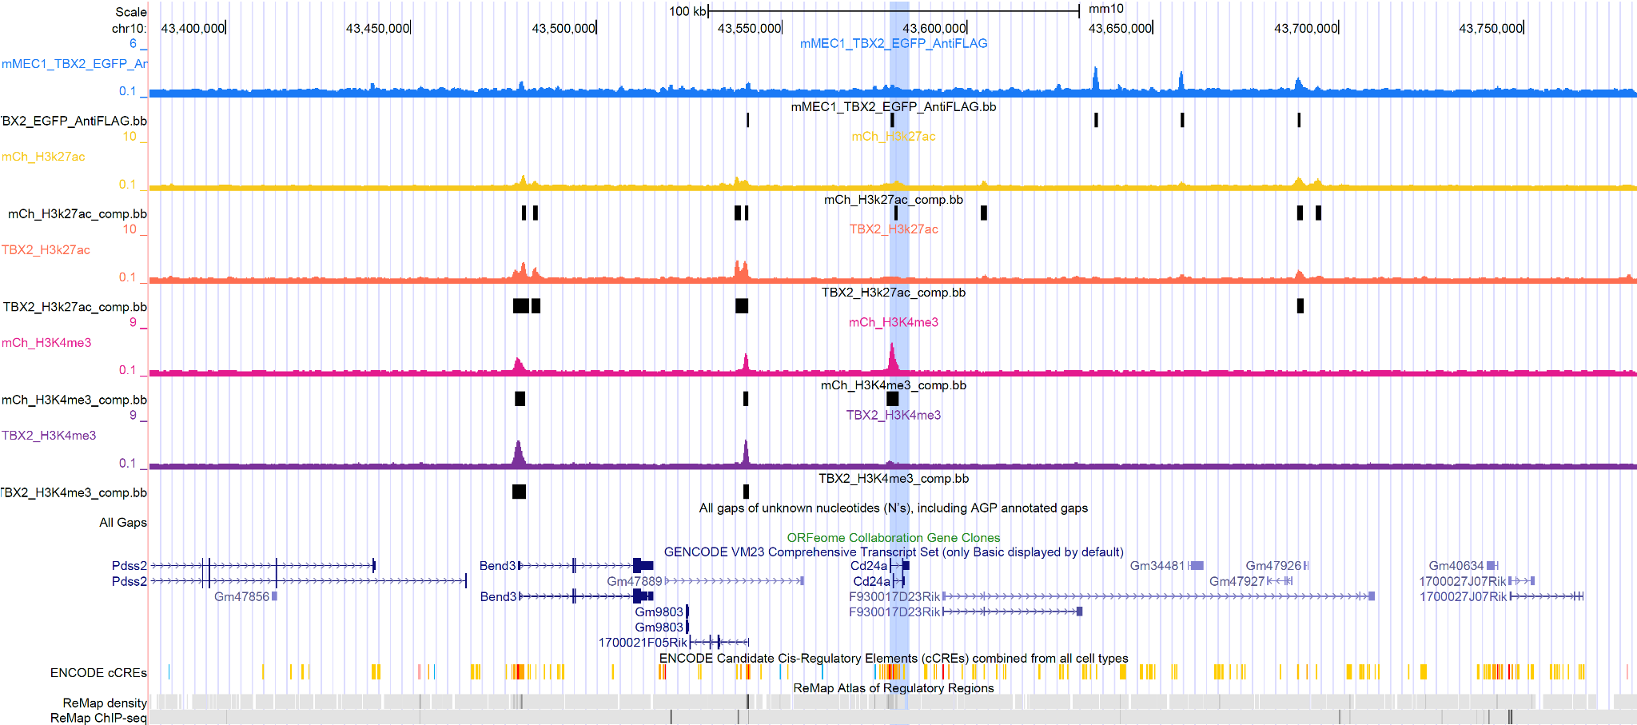
CD24a
Notes:
CD24a is used a marker for Cancer stem cells and promotes proliferation through MAPK and P13K/AKT pathways and helps with apoptosis and helps with immune evasion

Slide 22
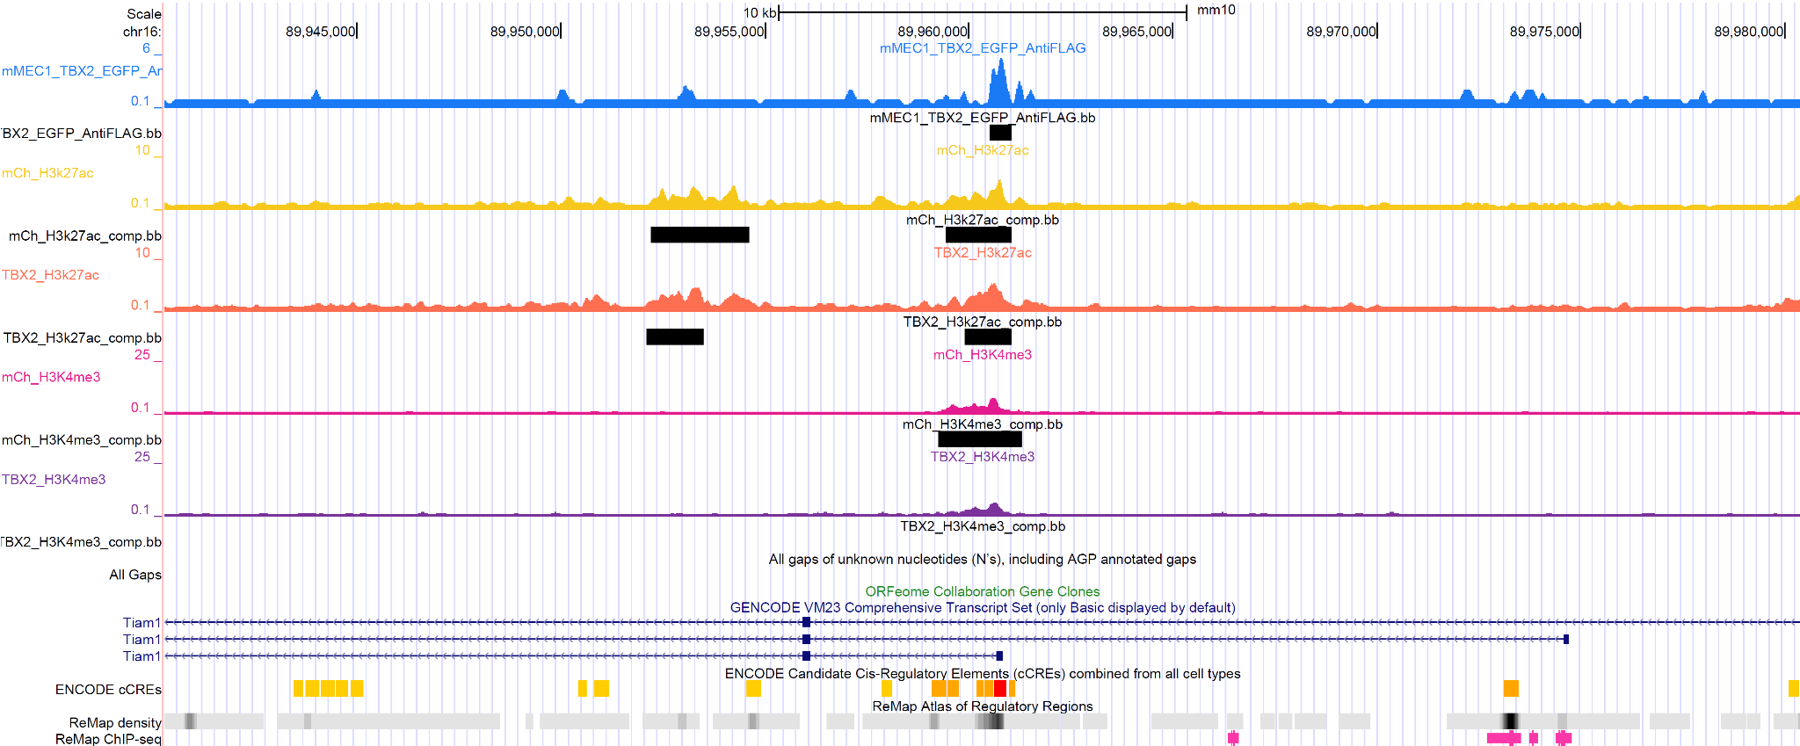
Tiam1
Notes:
TIAM1 activates rac1 and overexpression leads to increase migration (EMT)

Slide 23

Combination Matrix Analysis

Slide 24
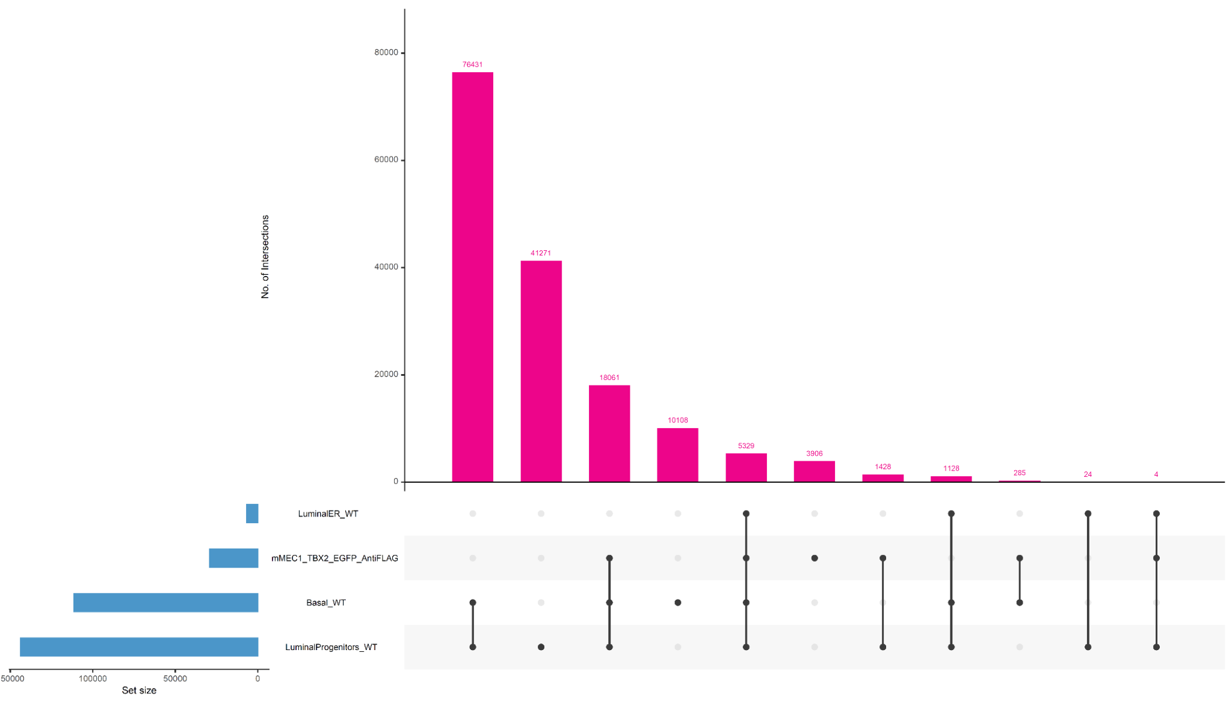
Cell Type Overlap Analysis

Slide 25
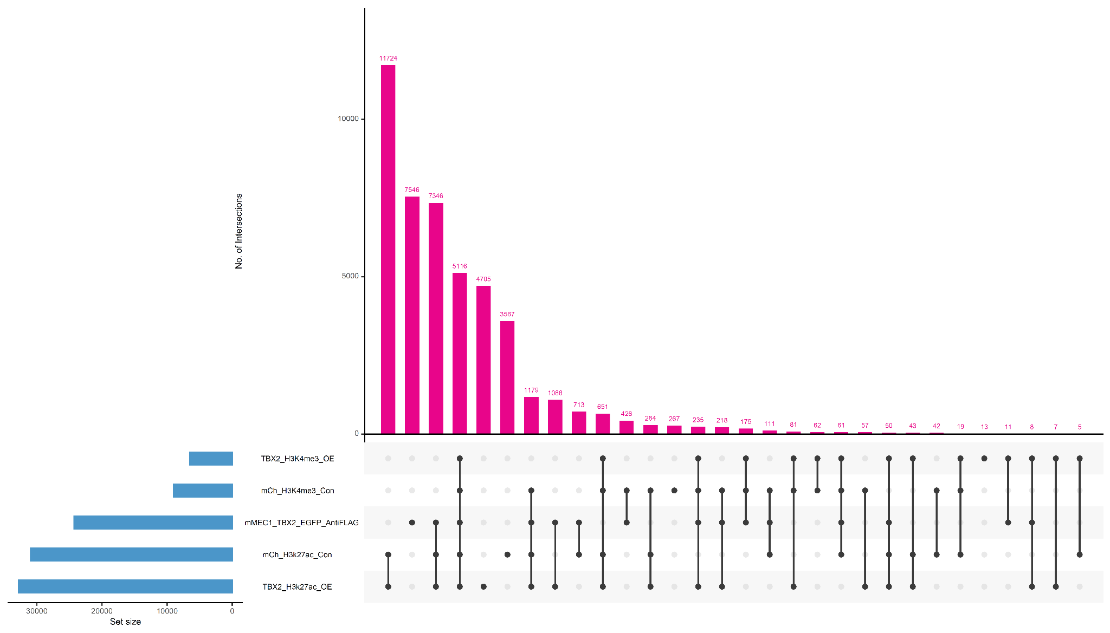
TBX2 Overlap Analysis

Slide 26
Conclusion
Enrichment of TBX2 binding overlaps with stem-like cells suggesting TBX2 involvement in dedifferentiate cells.
TCF4, NR6A1 and FOSL1 are enriched in H3K27ac when TBX2 is overexpressed possible suggesting enhanced cell proliferation
The overexpression of TBX2 in mMECs have a histone demethylation effect possibly by the KDM5A binding.

Slide 27
References
GEDI course
Chang F, Xing P, Song F, Du X, Wang G, Chen K, Yang J. The role of T-box genes in the tumorigenesis and progression of cancer.(2016)
Hanker, L. C., & Harter, P. (2012). The role of hormone therapy in the treatment of epithelial ovarian cancer. Expert Review of Anticancer Therapy
Fong, P. C., et al. (2009). "Inhibition of poly(ADP-ribose) polymerase in tumors from BRCA mutation carriers." New England Journal of Medicine, 361(2), 123-134.
Prat, A., & Perou, C. M. (2011). "Molecular subtypes in breast cancer." Human Pathology, 42(5), 629-641.
Alberts, B., Johnson, A., Lewis, J., Morgan, D., Raff, M. C., Roberts, K., Walter, P., Wilson, J. H., & Hunt, T. (2015). Molecular biology of the cell. Garland Science, Taylor and Francis Group.

Slide 28
Acknowledgements
Thank you everyone for having me!!

